Slide 1
Finding Flow Solutions: Productivity Practices in the Classroom
UNIT 1:
FOUNDATIONS OF FLOW
©2023 FindingFlowSolutions.com All Rights Reserved
Please do not share this resource or your own edited version in any capacity beyond your own
personal classroom use with students. Thank you for respecting our work!
Notes:
[Teacher reference page only]

Slide 2
1
UNIT INTRODUCTION
Notes:
BEGIN SLIDESHOW FOR STUDENTS HERE

Slide 3
Have you ever found yourself completely lost in an activity, and suddenly realized an hour had passed and you thought it had only been a few minutes?
Share some school-appropriate examples.
Sports
Gaming
Dancing
Social Media
Notes:
Read the slide.
Allow students to brainstorm.
Then click to reveal suggested responses.
(Students may mention sports, watching TikToks, playing video games, and hobbies. Share a time when you’ve experienced this too, maybe when lost in a deep conversation or engrossing movie. Try to elicit classroom-based experiences, as well: “I’ve experienced flow as a teacher! I completely lost track of time when ___ “)

Slide 4
Do you have a word or phrase for that experience?
In the zone
On the ball
In my groove
Notes:
Allow students to brainstorm, then click to reveal suggested responses.

Slide 5
5
A Hungarian-American researcher
in the 1970s named
Mihaly Csikszentmihályi
(we’ll call him Mr. C for short) invented a word for this.
Can you think what it might be?
He called it flow, and his research is referred to as “flow theory.”
Notes:
Read the statement (name is pronounced ME-high Cheek-SENT-me-high)
Allow students to brainstorm while the 11 second footage of the river flowing plays.
Click to reveal the answer.
[River video credit ©Angela Watson]

Slide 6
He studied writers, athletes, chess masters, artists, surgeons, and more.
What did Mihaly Csikszentmihályi
discover about flow?
He found that people got a lot of satisfaction not from relaxing, but from intense activities that required a lot of concentration.
He called their absorption in the task “flow” because many people described feeling like they were being carried by a current in the river as it flows.
Notes:
Read and discuss. (Name is pronounced ME-high Cheek-SENT-me-high)

Slide 7
1
1
LESSON 1
I can find my “flow state” in
the learning environment.
Notes:
Introduce the first lesson’s topic.

Slide 8
Here’s what you’ll learn in each
lesson about flow…
02
05
01
03
04
I can direct my focused attention.
I can develop a toolbox of strategies to help me find flow.
I can find my flow state in the learning environment.
I can problem solve when it’s hard to concentrate or be productive.
I can create habits that support energy and focus.
Notes:
Say, “We’re going to do 5 lessons together on the concept of flow.”
Click to reveal each topic.

Slide 9
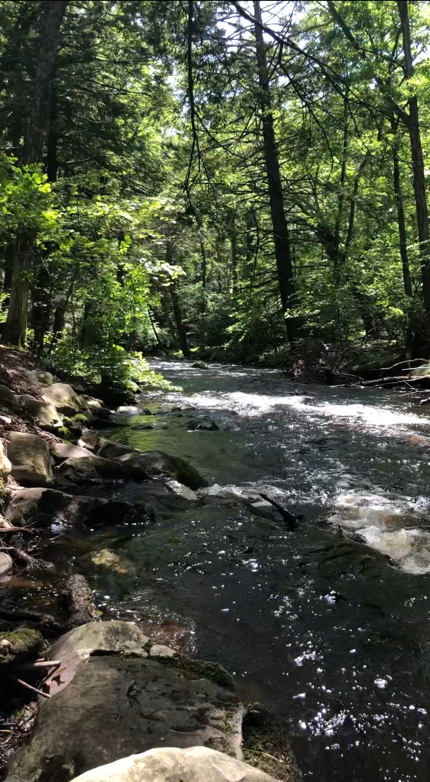
Why would we learn about
flow in school?
Flow is fun.
Flow makes concentration easier.
Flow gives us a sense of satisfaction about our work.
Flow helps us perform at our optimal level and produce our best work.
Flow makes learning and hard work more enjoyable.
Flow leaves us feeling energized after working instead of exhausted.
Notes:
Have students brainstorm if you’d like, then click to reveal each purpose for learning.

Slide 10
Activities that require learning and improving skills make it easier to feel the flow state.
Why should we try to find flow in the classroom?
We do those kinds of activities all the time in school.
When you lean to find flow in the classroom, you’ll be able to find it more easier outside of school in activities you enjoy.
Notes:
Read and discuss. Help students understand that flow will help them in gaming, sports, music, dancing, drawing, painting, acting, creative writing, and anything else they like doing.

Slide 11
9
Turn & Talk
Do you think it’s possible to experience flow in ANY activity?
Why or why not?
Do you think it’s possible to experience flow while doing school work?
Why or why not?
Notes:
Have students pair up to discuss two questions (click to reveal each one.) Students can choose whichever question interests them most or take turns answering both.

Slide 12
4 factors that make flow possible
Based on the research of Mihaly Csikszentmihályi
I'm totally present
Completely involved in the task and not thinking about anything else
I’m doing it for the flow
I understand
what’s needed
Flow is its own reward and I get satisfaction from the process
Know what needs to be done and how well I’m doing
I know I’ve
got this
Confident that my skills match the task
Notes:
Click to reveal and discuss each one. Guide students to understand that if any of these are missing, it’s harder to find your flow.
(Name is pronounced ME-high Cheek-SENT-me-high)

Slide 13
Did you change your thinking
about either question?
11
Do you think it’s possible to experience flow in ANY activity? Why or why not?
I'm totally present
Do you think it’s possible to experience flow while doing school work? Why or why not?
Completely involved in the task and not thinking about anything else
I’m doing it for the flow
I understand
what’s needed
Flow is its own reward and I get satisfaction from the process
Know what needs to be done and how well I’m doing
I know I’ve
got this
Confident that my skills match the task
Notes:
Ask students to revisit their earlier answers in light of the 4 factors that make flow possible.
Conclude by saying, “Flow is not something we’ll get to experience every moment of every day. And, the things that help us get into a state of flow will change over time. So, we’re going to approach this as an experiment: one that we’ll start together in class this week, but that hopefully you’ll continue all throughout your life.

Slide 14
How do you know you’ve experienced a flow state?
You lost track
of time.
Your normal distractions weren’t as tempting.
You’re still thinking about the task after it’s done.
You might not notice while you’re in a flow state, but when time is up, you say, “I can’t believe the class period is over already!”
You aren’t thinking about snacks, games, checking your phone, etc.
It’s hard to stop when time is up, and you think about the task again afterward
Notes:
Let kids brainstorm answers.
Click to reveal each answer and discuss.

Slide 15
Let’s find flow as often as possible, instead of just trying to force ourselves to get work done.
CLOSING THOUGHTS
Notes:
Read closing thoughts to students.
Say, “Flow is one of the optimal human states of being: we feel great and we achieve great things when in a state of flow. I want us ALL to experience more of that in our classroom. We’re going to try to find flow instead of just forcing ourselves to get our work done. That’s the purpose of this unit of study.”

Slide 16
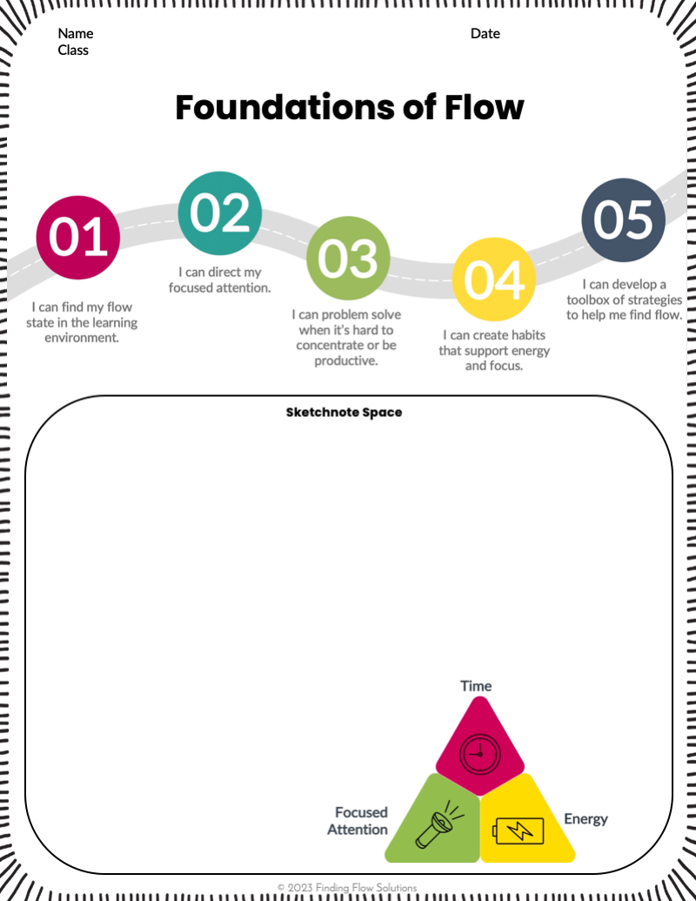
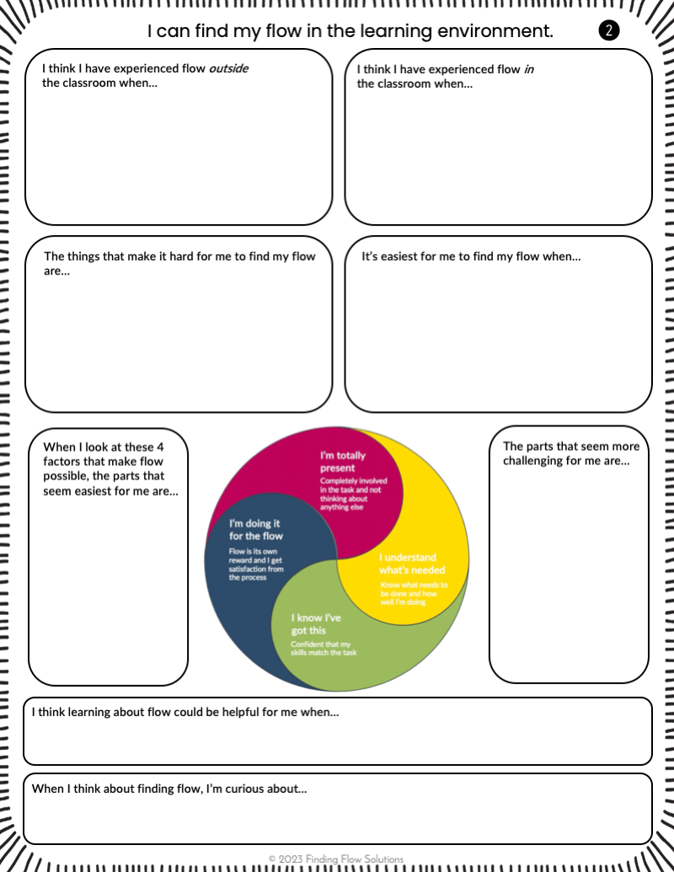
14
Journal Activity
Fill out the heading
on the cover page
Complete the
reflections on page 2
1
2
Notes:
Distribute the printed or digital version of the journal to students and have them complete these 2 tasks (allow 5-7 minutes.)

Slide 17
1
2
LESSON 2
I can direct my
focused attention.
Notes:
BEGIN LESSON 2 HERE. Introduce the day’s topic.

Slide 18
Here’s where we are on
our roadmap toward finding flow…
02
05
01
03
04
I can direct my focused attention.
I can develop a toolbox of strategies to help me find flow.
I can find my flow state in the learning environment.
I can problem solve when it’s hard to concentrate or be productive.
I can create habits that support energy and focus.
Notes:
Review the unit overview and where today’s topic fits in.

Slide 19
17
Turn & Talk
What is a flow state?
What does it look like to have “energized focus” and be completely involved in class work?
Notes:
Have students pair up to discuss the first question.
Take students’ answers, and say “A flow state is when a person is fully immersed in a feeling of energized focus, completely involved in what they’re doing, and enjoying the process of the activity.”
Click to reveal the second question, and allow students to discuss.

Slide 20
What does it mean
to focus your attention?
Notes:
Click to play the 1 minute closed-caption audio OR read the transcription below.
AUDIO TRANSCRIPTION:
-When you’re in a flow state, your attention is focused on the thing you want it to be focused on. This requires being in control of your attention. Think of focused attention as a flashlight. There are many different objects in a room, but wherever you shine the flashlight is where the light is focused.
-Many times our flashlight of attention feels like its swinging all over the place: the task at hand, our phones, the noise in the hallway, the person next to us who’s talking, and so on. It’s more like swing lights on a concert stage than a flashlight. Learning to focus your attention is like learning to control the direction of the flashlight. It’s choosing which things to illuminate, light up, and bring attention to, and which to leave in relative darkness.
-Directing your attention requires control, and that requires practice. The more that you practice shining the flashlight of your attention in one spot and holding the flashlight there, the easier it becomes to do it again.

Slide 21
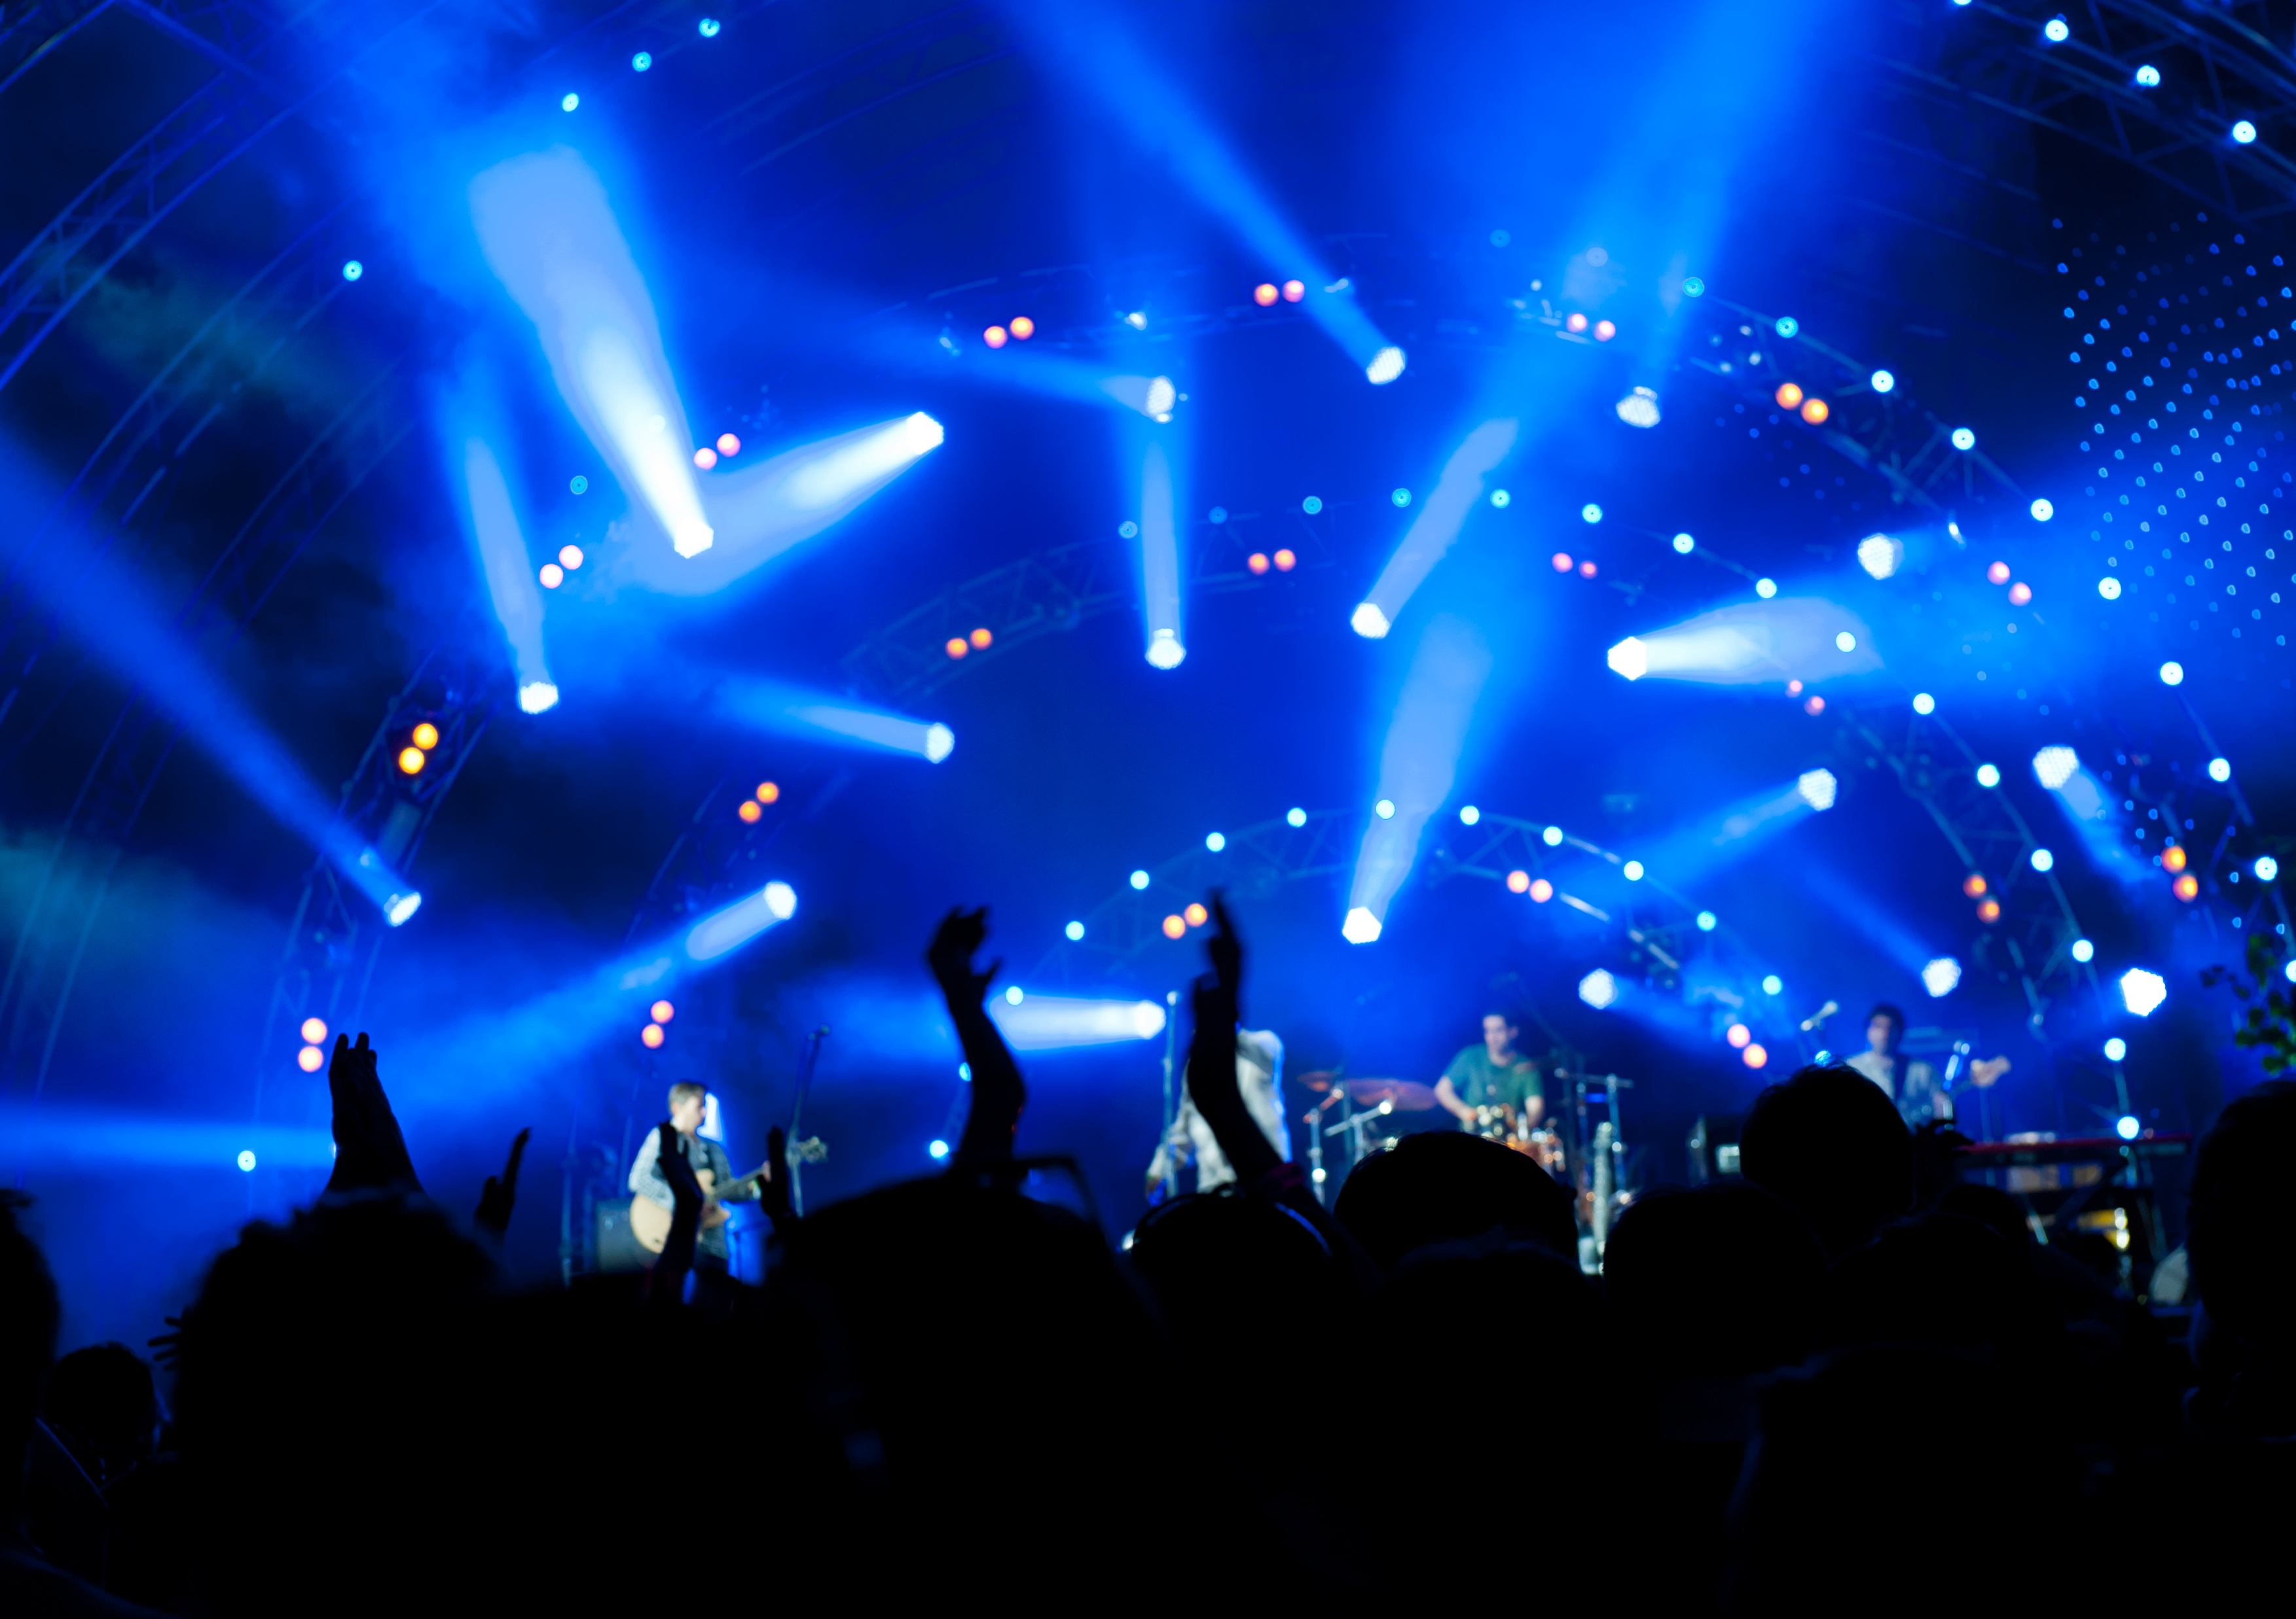
19
vs.
Flashlight
Swing Stage Lights
Notes:
Discuss the flashlight and swing stage lights analogy from the video.
Ask, “How do YOU direct your attention, focus, and concentrate?”

Slide 22
Eliminate distractions
1
Get comfortable in a quiet place with devices silenced.
Get clear on the task
2
5 steps to creating a flow state
Figure out what needs to be done and your next steps.
Visualize the outcome
3
Picture the results and how you’ll feel when the task is done.
Set a timer for 20-45 min.
4
Give yourself a reasonable time period to get and stay in flow.
Focus your attention
5
Start with what feels easier and build on that until you get into the flow.
Notes:
Say, “I’m going to share one process that can help.”
Click through and discuss each step.
At the end, say, “The last step is the most important: you have to put your undivided attention on the task. If your mind wanders, that’s okay! Just bring your focus back to the task. Imagine a flashlight that is swinging all around and you bring it back to your assignment. Remember that the first 15 minutes is the hardest, and if you can push through that, you’ll often wind up in a state of flow.”

Slide 23
Eliminate distractions
1
Get comfortable in a quiet place with devices silenced.
Get clear on the task
2
Here’s how this can look in our classroom.
Figure out what needs to be done and your next steps.
Visualize the outcome
3
Picture the results and how you’ll feel when the task is done.
Set a timer for 20-45 min.
4
Give yourself a reasonable time period to get and stay in flow.
Focus your attention
5
Start with what feels easier and build on that until you get into the flow.
Notes:
Say, “I want to give us all a chance to practice this now. One of your tasks this week is to ___. We’re going to see if you can get into the flow state with that task. I’m going to model each of the 5 steps for you.”
1. Eliminate distractions: Get comfortable in a quiet place with devices silenced
Say, “I’m going to get all my materials together and get you in a quiet place where I can focus.”
2 . Get clear on the task: Figure out what needs to be done and your next steps.
Say, “Now I’m going to familiarize myself with what needs to be done. I’ll look over the directions, review where I left off, and figure out what I need to do next.” [Give specifics if possible that are related to the task kids are doing.]
3. Visualize the outcome: Picture the results and how you’ll feel when the task is done.
Say, “When I’m done, I will have a completed ___ and I’ll be finished with ___. It’s going to feel amazing to know I have that part accomplished because it requires a lot of concentration. I’ll be able to do the easier and more fun steps of ___ afterward.”
4.Set timer for 20-45 min: Give yourself enough a reasonable time period to get and stay in flow.
Say, “I need at least 20 minutes to get into a flow state, and 45 minutes is around the maximum amount of time I can really concentrate without needing a break. Today, I’m going to set the timer for ___.”
5. Focus your attention: Start with what feels easier and build on that until you get into the flow.
Say, “Once all those steps are done, I’m going to envision my attention like a flashlight and shine it directly onto the assignment. I’m going to try to stay focused on the task for the whole time period so I can enter a flow state. When I feel stuck or it gets too hard, I’ll skip around to some other part of the task that feels easier. Then I can experience some success and I’ll come back to the harder stuff.”

Slide 24
Eliminate distractions
1
Get comfortable in a quiet place with devices silenced.
Get clear on the task
2
Figure out what needs to be done and your next steps.
Try it out!
Visualize the outcome
3
Picture the results and how you’ll feel when the task is done.
Set a timer for 20-45 min.
4
Give yourself a reasonable time period to get and stay in flow.
Focus your attention
5
Start with what feels easier and build on that until you get into the flow.
Notes:
Prepare students to try it out. Set a timer for the duration of the task.

Slide 25
Debrief: Were you able to find flow?
These 4 factors must be present in order for you to enter a flow state.
Notice which ones were challenging for you.
I'm totally present
Completely involved in the task and not thinking about anything else
I’m doing it for the flow
I understand
what’s needed
Flow is its own reward and I get satisfaction from the process
Know what needs to be done and how well I’m doing
I know I’ve
got this
Confident that my skills match the task
Notes:
When time is up, ask students to share if they were able to find flow, and which elements were missing for them.
Afterward, say, “It’s okay if this was tough. Flow doesn’t happen every time we try and often there are distractions in school that make it hard. But the more often you enter a flow state, the easier it is to find your way back to that flow state again in the future.”

Slide 26
Flow gets easier
with practice, and we’ll keep practicing together throughout the school year.
CLOSING THOUGHTS
Notes:
Read and discuss.

Slide 27
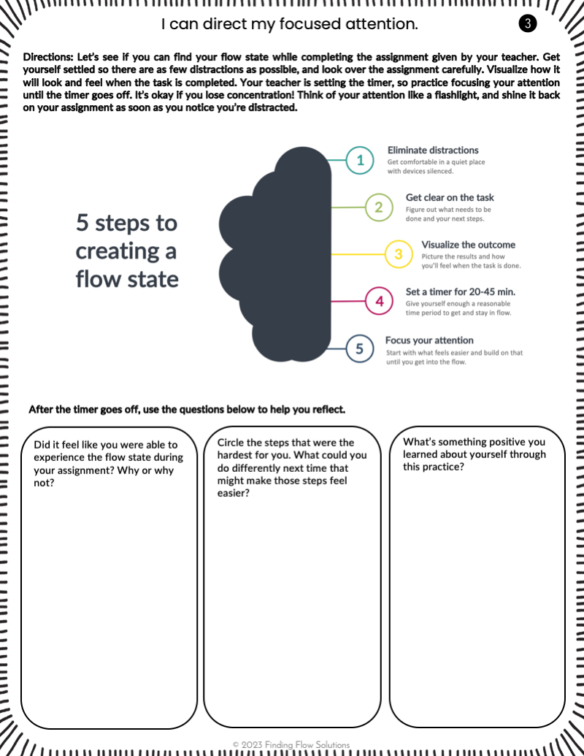
25
Journal Activity
Use page 3 of your journal to help you reflect on flow during the task you just completed.
Notes:
Introduce the reflection activity in students’ journals and release students to complete it (3-5 min.)

Slide 28
1
3
LESSON 3
I can problem solve when it’s hard to concentrate or be productive.
Notes:
BEGIN LESSON 3 HERE. Introduce the day’s topic.

Slide 29
Here’s where we are on
our roadmap toward finding flow…
02
05
01
03
04
I can direct my focused attention.
I can develop a toolbox of strategies to help me find flow.
I can find my flow state in the learning environment.
I can problem solve when it’s hard to concentrate or be productive.
I can create habits that support energy and focus.
Notes:
Review the unit overview and where today’s topic fits in.

Slide 30
What does it
mean to be
productive?
Notes:
Say, “I want to do a deeper dive into one of the purposes of flow and concentration, which is productivity. What does it mean to be productive?”
Let students share their thoughts.
Then click to play the 1 min 20 second video explanation OR read the transcription below.
CLOSED CAPTION AUDIO TRANSCRIPTION:
-Productivity refers to the amount of work you can get done in a given time period.
-Productive people get more more done with less time and effort.
-There are a mix of factors that lead to greater productivity, including motivation, personality, natural talent, training, education, environment, support from others, time management, and even luck.
-Exercise, healthy eating, and sufficient sleep can also help with productivity so you work more effectively and quickly.
-Some people seem to be natural super-producers; others struggle to become more productive and may rely more on daily practices and better habits to help them get things done. Both ways of being are okay!
-You can create habits that support productivity by managing your time, energy, and focused attention.
-And, you’ll probably find it’s easier to be productive when you’re well-rested and not stressed out. It’s also easier to be productive when the task is something you meaningful or valuable.
-Everything we have to get done in a day won’t hold deep personal meaning, but tapping into our flow state can make getting things done and being productive feel easier and more enjoyable.

Slide 31
There’s only so much time in a day, a year, and a life.
What does it mean to be productive?
Productivity is the ability to work efficiently within the given time to maximize output.
Productivity means using your time well to produce the results you want.
Notes:
Review the main ideas from the video (click to reveal each one.)

Slide 32
The 4 factors
which make flow possible
I'm totally present
Completely involved in the task and not thinking about anything else
I’m doing it for the flow
I understand
what’s needed
Flow is its own reward and I get satisfaction from the process
Know what needs to be done and how well I’m doing
I know I’ve
got this
Confident that my skills match the task
Notes:
See if students can recall each one.
Click to reveal.
Say, “Yesterday when we practiced, it was hard to get all 4 happening. So let’s talk about why.”

Slide 33
Help! I can’t
find my flow. I feel…
Unpresent
Unclear
Unconfident
Unmotivated
Distracted by other problems
Distracted by something that happened earlier
Distracted by something that may be happening later
Confused about what to do to be successful
Unfamiliar with the skills or background info needed for this task
Unsure how to get started
Stuck on a specific part of the task
Not skilled enough to do this task well
Unsure that I have enough time to do this well
The task isn’t interesting
The task isn’t meaningful
The process for the task doesn’t work well for me
Tired of concentrating and need a break
A need to rest, eat something, have a drink, or use the bathroom
Notes:
Click to reveal 4 main causes of not being able to get into a flow state.
Ask students to discuss what they think “unpresent” means, then click to reveal.
Repeat with the other 3.

Slide 34
How to get into the flow
when you feel…
Unpresent
Unclear
Unconfident
Unmotivated
Choose a time to think or talk about your problems later
Take 5 deep breaths and turn your attention to your breathing.
Tell yourself, “I am okay here right now.”
Ask a friend or your teacher to explain the task a different way.
Ask someone the first thing you should do and how to get started.
Get help with the part of the task that you can’t do on your own.
Ask your teacher if there is an accommodation or a different way to get the task done.
Get started on the part you feel most confident about.
Skip around in the task, doing what you know best and building from there.
Find a part of the task that seems more interesting.
Think about how the task will help you with a more meaningful task later.
Ask if you can try a different process.
Take a short break and try again in a few minutes
Notes:
Click to reveal solutions for each problem, allowing students to suggest additional ideas if they have any.
Then say, “We’re going to do a journal activity that will help you practice diagnosing obstacles to flow–in other words, help you figure out what keeps you from feeling flow and how to move past that.”

Slide 35
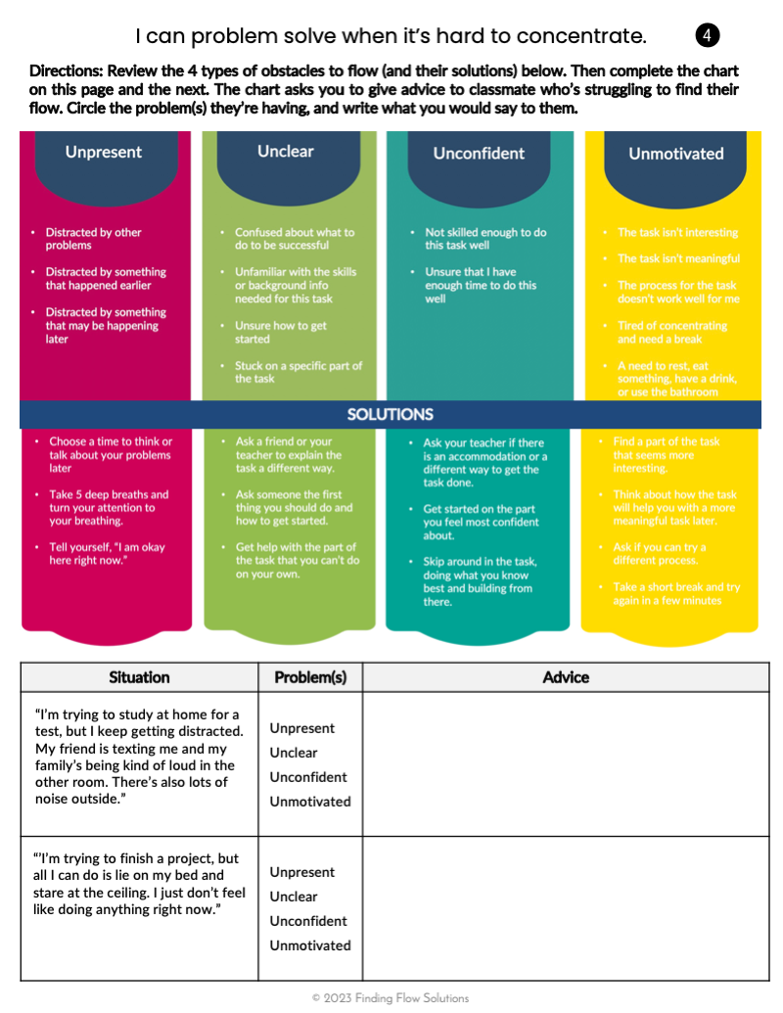
33
Journal Activity
Look at page 4.
Follow your teachers’ directions to give advice for the first situation.
1
Notes:
Distribute journals. Complete the first box together (read the situation, decide/circle which problem(s) are occurring, and compose advice for the hypothetical student in the example who is experiencing that problem.)

Slide 36
34
Journal Activity
Follow your teachers’ directions to give advice for the second situation on page 4.
2
Notes:
Complete the second example together.

Slide 37
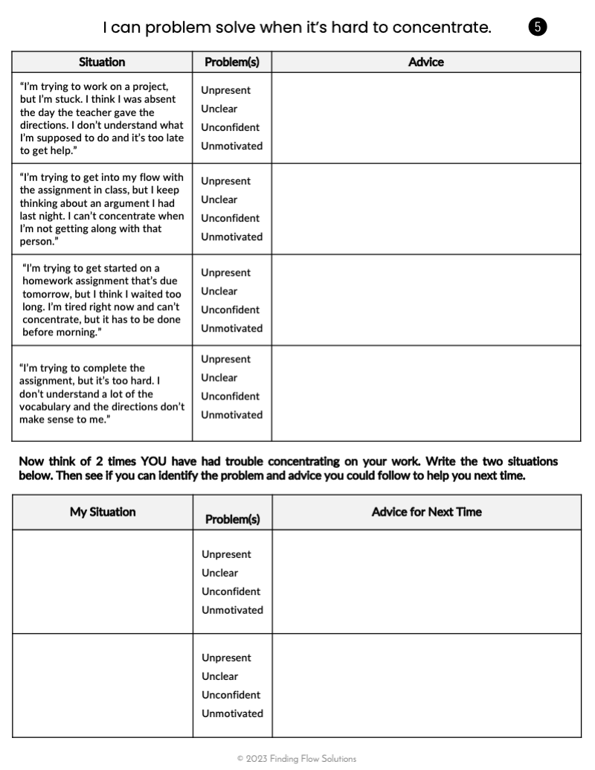
35
Journal Activity
Now try page 5 on your own, with a partner, or group.
3
Notes:
Release students to complete page 5 (allow around 10 min.)

Slide 38
Our goal with school work is to be productive: to use our time well to produce the results we want. The flow state is one of the easiest and most enjoyable ways to be productive.
CLOSING THOUGHTS
Notes:
Read and discuss.

Slide 39
1
4
LESSON 4
I can create habits that support
energy and focus.
Notes:
BEGIN LESSON 4 HERE. Introduce the day’s topic.

Slide 40
Here’s where we are on
our roadmap toward finding flow…
02
05
01
03
04
I can direct my focused attention.
I can develop a toolbox of strategies to help me find flow.
I can find my flow state in the learning environment.
I can problem solve when it’s hard to concentrate or be productive.
I can create habits that support energy and focus.
Notes:
Review the unit overview and where today’s topic fits in.

Slide 41
39
Turn & Talk
A flow state is when…
Being in a flow state helps us…
Notes:
Have students pair up to review the previous concepts taught in this unit.
Afterward, guide students to understand that a flow state is when a person is fully immersed in a feeling of energized focus, completely involved in what they’re doing, and enjoying the process of the activity. Being in a flow state helps us accomplish our work and be productive. It’s a good use of our time and energy.

Slide 42
Finding flow
includes
managing your…
Time
Focused Attention
Energy
Notes:
Brainstorm with students.
Click to reveal time, energy, and focused attention.
Say, “Finding flow in the classroom includes managing focused attention, but also time and energy. All three are essential for getting things done. Time is at the top because that’s what we often think about when getting work done but it’s propped up by energy and attention.”

Slide 43
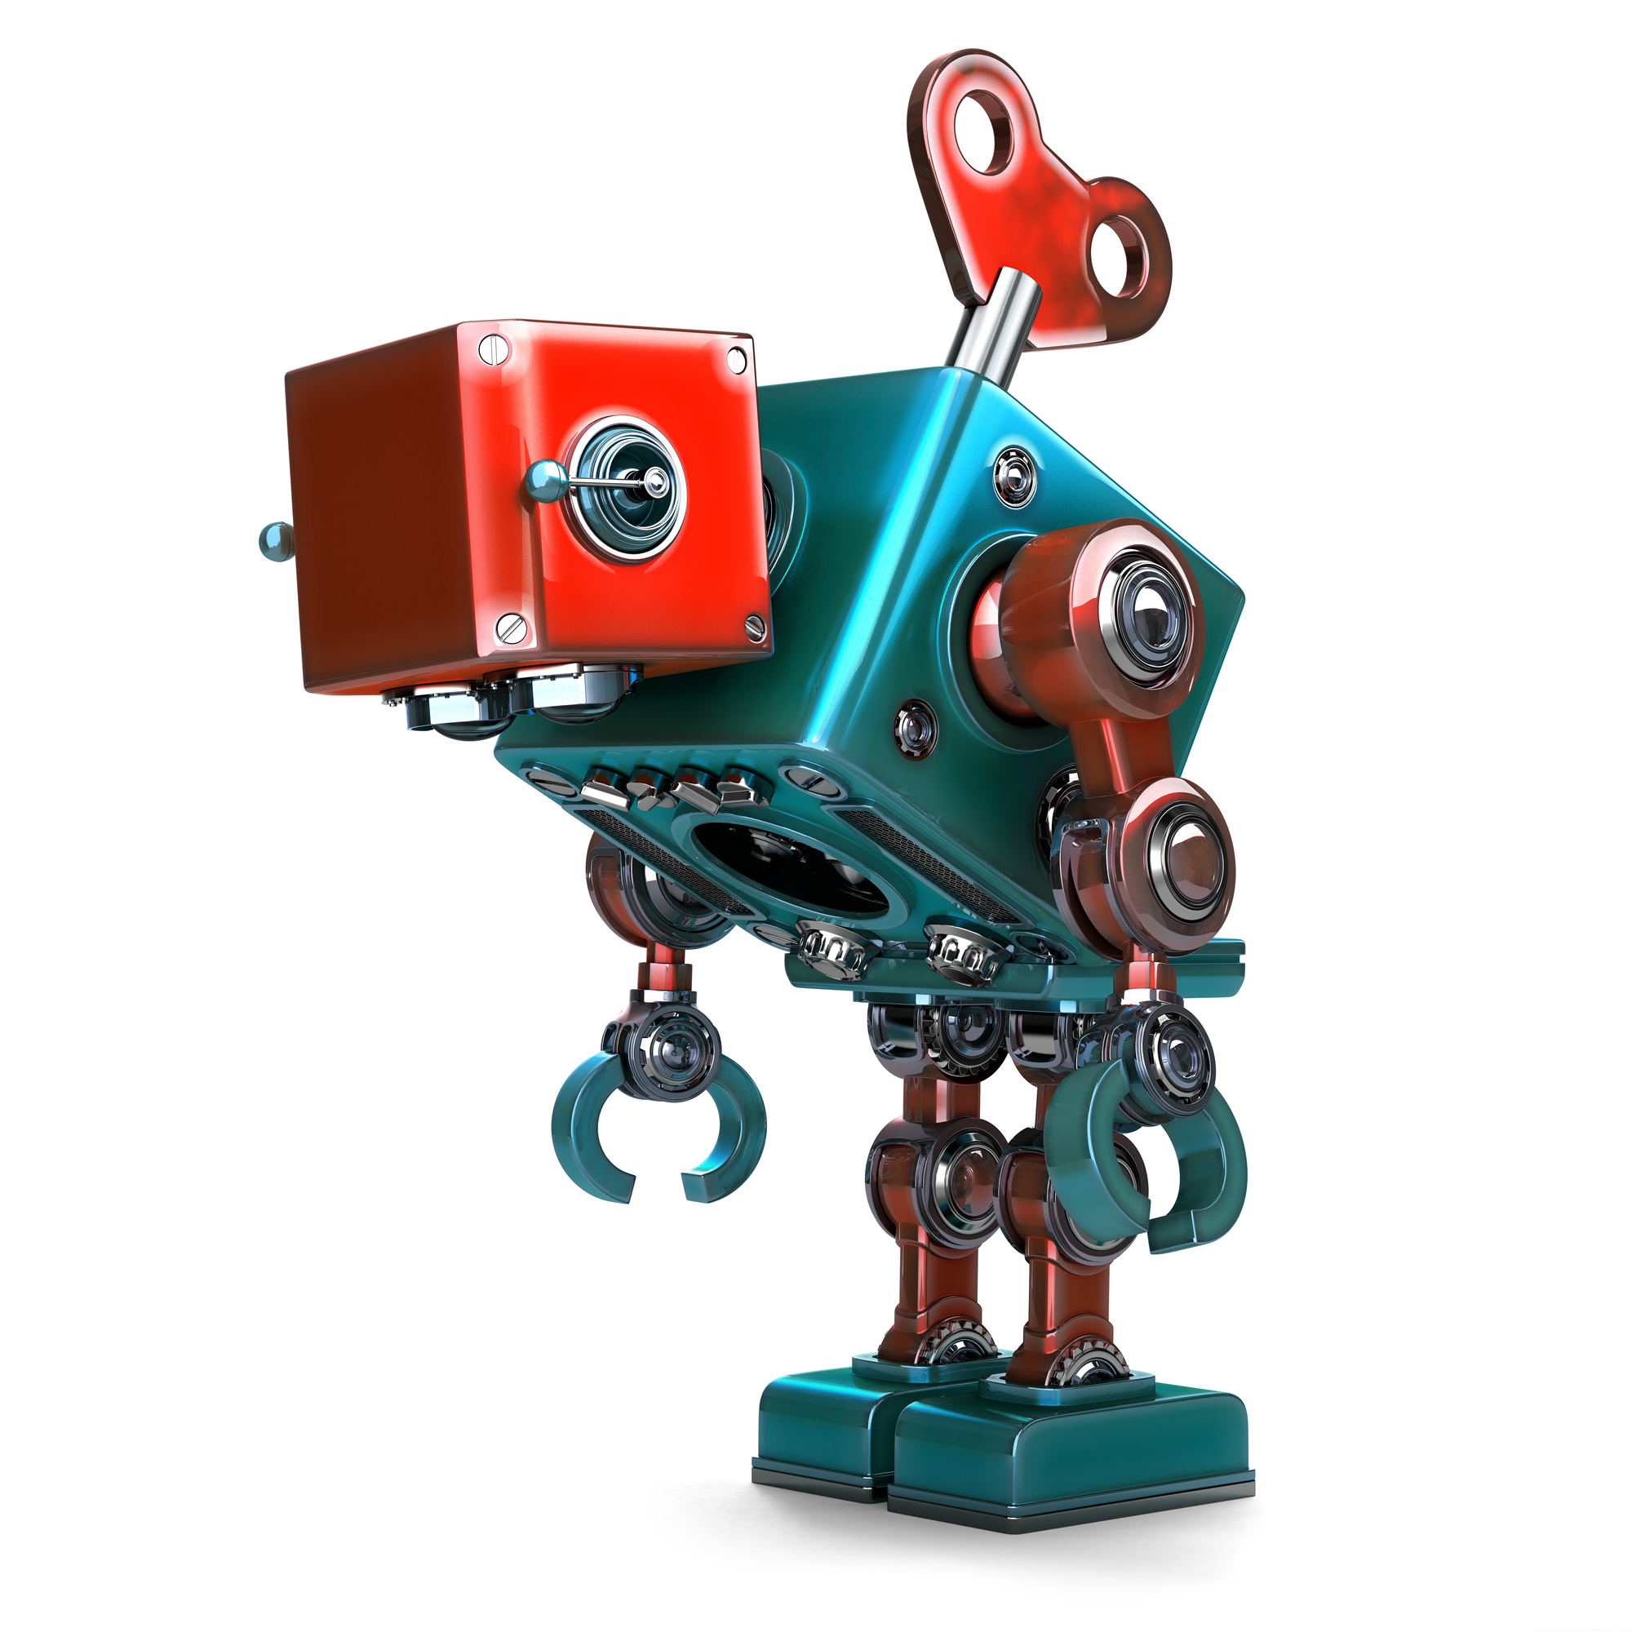
41
Attention is like a flashlight.
Energy is like a
wind up toy.
Notes:
Say, “We talked previously about how attention is like a flashlight. Energy, on the other hand, works a bit like a wind-up toy. These toys have the ability to go wild at first and slow down gradually as their “energy” runs out. When they’re wound up again, they have more “energy.”

Slide 44
Energy, unlike time, doesn’t automatically replenish itself each day.
What does it mean to manage your energy?
You have to take care of your body and mind, and allow yourself time to rest and recharge.
Pay attention to which daily habits AND work habits maximize your energy.
Notes:
Read and discuss each of the 3 principles.

Slide 45
How your daily habits affect
your energy levels
Outside Time
Sleep & Rest
Phone Break
Fun & Hobbies
Has it been too long since you’ve gotten fresh air?
Have you been staying up later than you mean to?
Have you lost too much time to scrolling social media?
Have you been working too much with no time for fun?
Take a short walk or just get outside every day. No phone, no music, just the outdoors.
Unwind before bed so you can sleep earlier, or try taking a nap.
Turn off your phone for awhile and be present in your offline life.
Set aside a block of time for doing something that makes you feel energized.
Notes:
Click to reveal each type of habit, the reflection question, and the possible solution. Encourage students to share their own understandings.

Slide 46
44
Do you prefer…
Working for a long period of time and taking one long break afterward?
Working for shorter periods of time and taking multiple short breaks?
OR
Notes:
Say, “Let’s think about habits in class now.” [The next two slides are in this same format.]
Read the slide.
Have students discuss with a partner or group, or keep the activity whole-class by reading each option aloud and having students raise their hands to show which they prefer.

Slide 47
45
What is your best time of day for concentrating on school work?
Early in the morning
Later in the morning
Afternoon/
evening
At night
OR
OR
OR
Notes:
Have students discuss with a partner or group, or keep the activity whole-class by reading each option aloud and having students raise their hands to show which they prefer.

Slide 48
46
Which do you prefer when doing school work?
Sitting down
Standing up
Lying down
A mix of these
OR
OR
OR
Notes:
Have students discuss with a partner or group, or keep the activity whole-class by reading each option aloud and having students raise their hands to show which they prefer.

Slide 49
It’s normal for your habits to change depending on the task and your mood. Productivity is a
life-long experiment!
CLOSING THOUGHTS
Notes:
Read and discuss.
Say, “I noticed some of you had trouble picking an answer at times. Do you feel like your answers change according to the day and task?”
Discuss.
Say, “That’s very normal! Your answers will change over time as your needs and preferences change. Productivity is a lifelong experiment.”

Slide 50
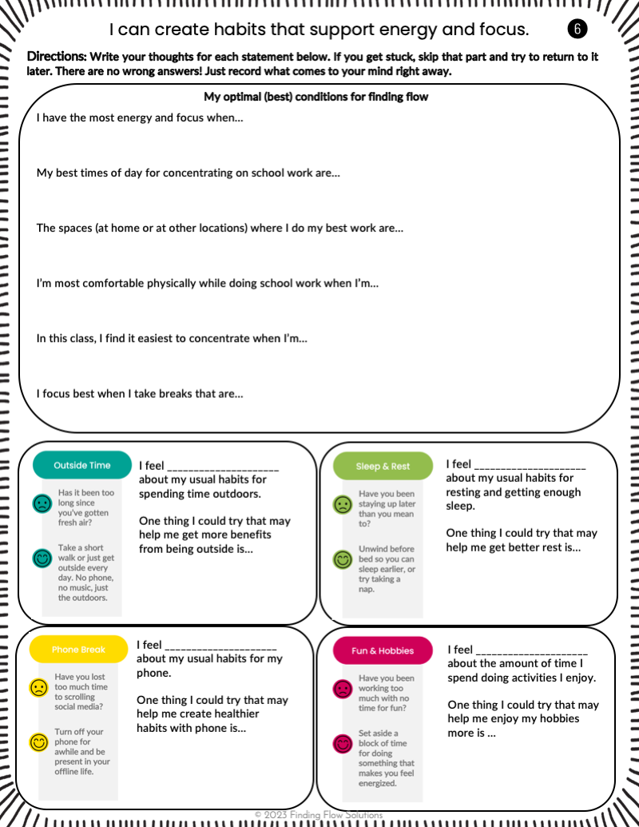
48
Journal Activity
Use page 6 of your journal to help you reflect.
Notes:
Introduce the reflection activity in students’ journals and release students to complete it (allow 5-7 min.)

Slide 51
1
5
LESSON 5
I can develop a toolbox of strategies
to help me find flow.
Notes:
BEGIN LESSON 5 HERE. Introduce the day’s topic.

Slide 52
We’re at the last stop on our roadmap
toward finding flow!
02
05
01
03
04
I can direct my focused attention.
I can develop a toolbox of strategies to help me find flow.
I can find my flow state in the learning environment.
I can problem solve when it’s hard to concentrate or be productive.
I can create habits that support energy and focus.
Notes:
Review the unit overview and let students know this is the final lesson.

Slide 53
When you don’t have energy
and can’t concentrate…
Physical activity
What else?
Fresh air or nature
What kinds of things can help you get ready to learn and work again?
Talking with others
Resting
Doing something you enjoy
Notes:
Click to reveal each possible solution.
When you show “What else?” ask students to brainstorm as a class, or with a partner or group.

Slide 54
You can collect strategies that make it easier to get your work done when you feel unmotivated.
Notes:
Read the slide.
Say, “When you’re feeling tired, or like your brain is full and you can’t process anything else, think about what you can do to get back into a space where you’re ready to learn again. This next activity will help. So when your head hurts from concentrating on an assignment and you don’t feel like you can do any more work, you can look back at your journal and find helpful strategies.”

Slide 55
Imagine a type of toolbox you’d like to have.
It could be for hand and power tools, garden tools, car wash tools, makeup tools, artist tools, writing tools, or anything else you enjoy.
Notes:
Read the slide. Students may suggest other types of toolboxes.

Slide 56
Design a toolbox of choices
Identify strategies that have helped you find your flow in the past. Then when you’re stuck, you can choose the one that feels easiest.
Notes:
Read the slide.

Slide 57
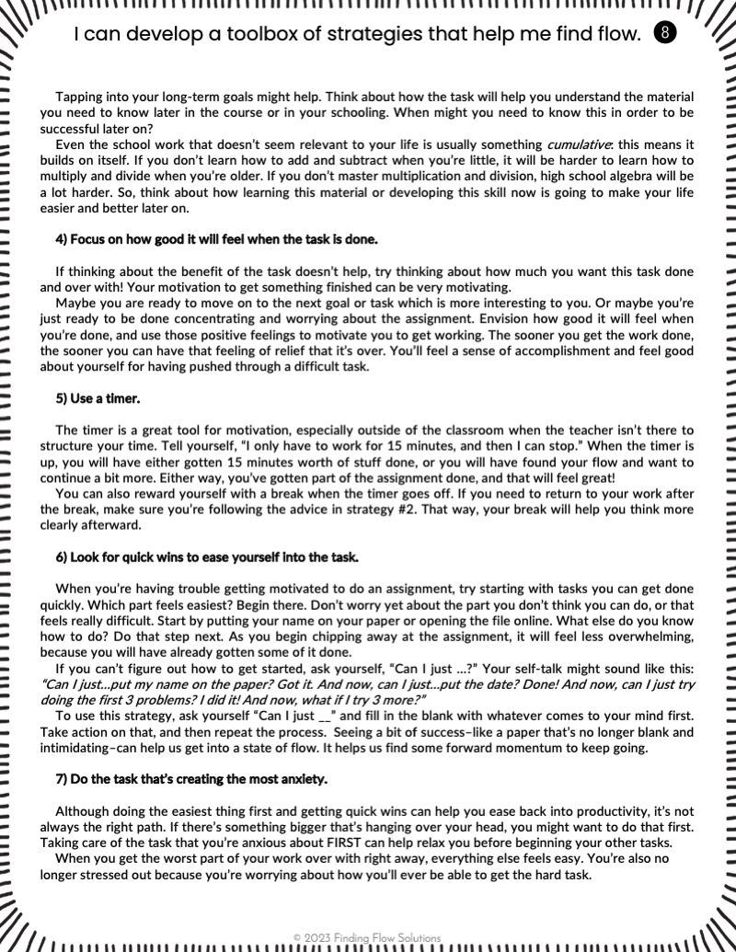
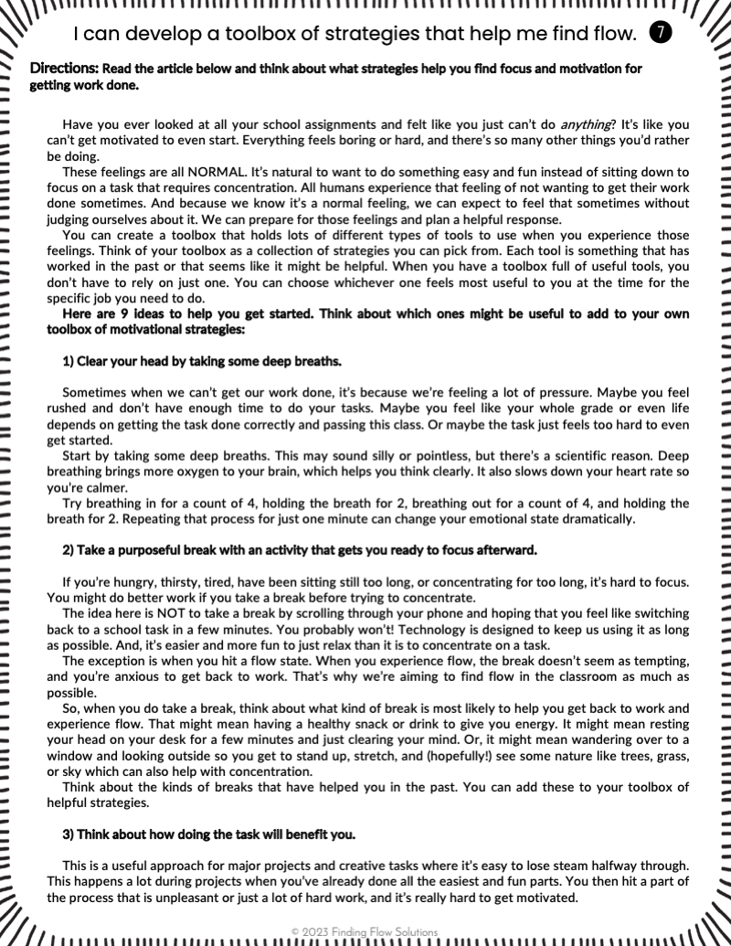
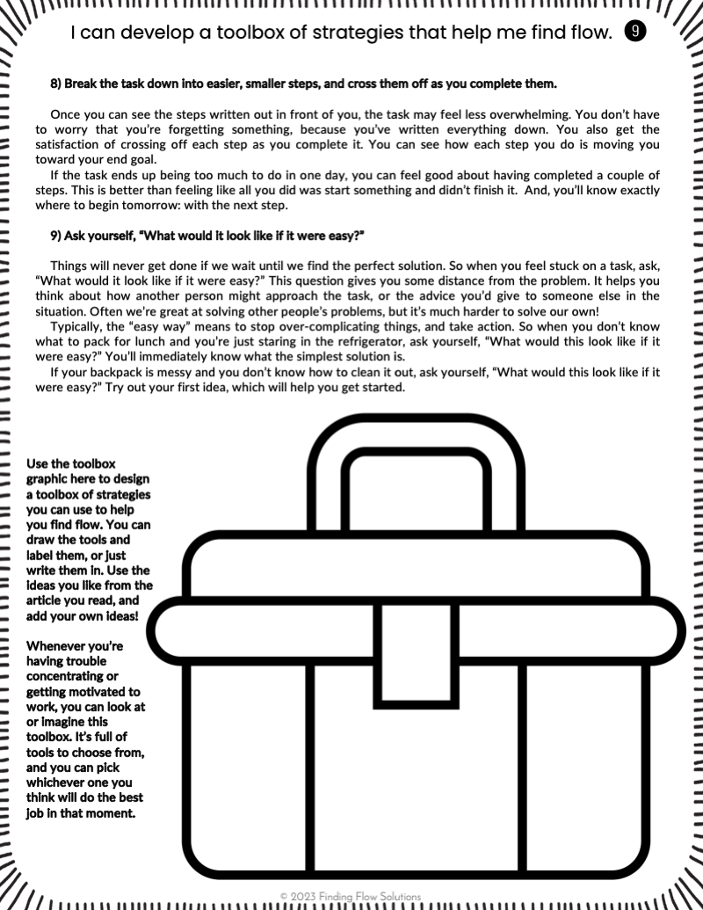
55
Journal Activity
Read the article on pgs 7-9
Design your toolbox
It will give you strategies to use when you’re having trouble getting your work done.
Use the toolbox on pg. 9
to write/draw strategies that you like. Add more sections to the toolbox if needed. You can use ideas from the article along with your own ideas.
Find quick wins
Use timers
Take a break
Stand up and stretch
1
2
Notes:
Introduce the reflection activity in students’ journals and release students to complete it (allow 15-20 min.)

Slide 58
56
Share It Out
What other strategies
did you think of?
Notes:
Debrief from the article and toolbox activity in students’ journals.

Slide 59
Add to your toolbox as you think of more ideas. Experiment! Over time, you’ll develop your own personal collection of tools to choose from when you feel overwhelmed.
CLOSING THOUGHTS
Notes:
Read and discuss.

Slide 60
Which topics are you interested
in exploring next?
Foundations of Flow
Attention Management
Completing work with ease,
enjoyment, and satisfaction
Learning how to focus and
concentrate on things you want to do
Self-Directed Learning
Productivity
Practices
Energy & Stress Management
Setting goals and taking control
of what and how you learn
Creating healthy daily habits to
balance rest and productivity
Time Management
Creative Thinking
Prioritizing and planning
for getting things done
Expressing yourself and problem
solving in new and different ways
Notes:
Say, “While this unit is over now, we’re going to continue experimenting with productivity throughout the school year. I’d like to know what you’re most interested in learning about.”
Click to reveal each option.
[Copy/paste the checkmark icon if students have already completed any additional units.]

Slide 61
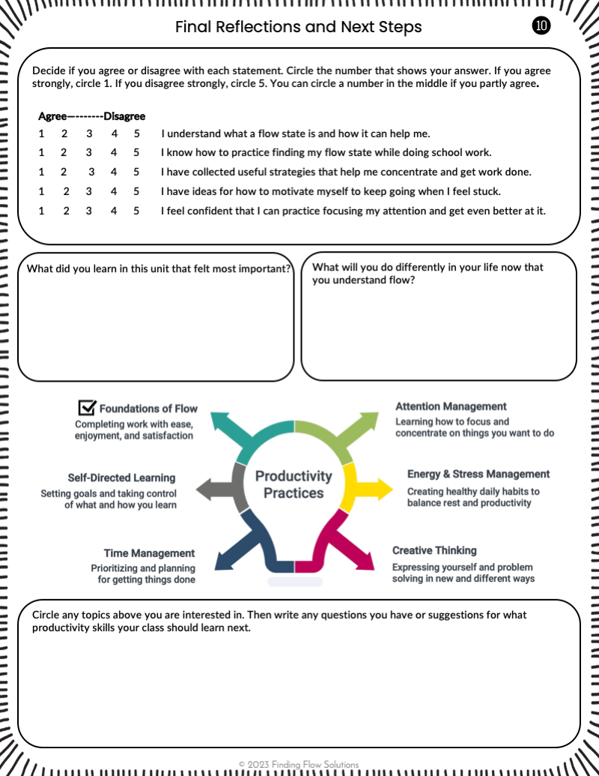
59
Journal Activity
Use page 10 of your journal to
help you reflect.
Notes:
Introduce the reflection activity in students’ journals and release students to complete it (allow 5 min.)

